Slide 1

Using Object-Oriented JavaScript
Web Development with JavaScript

Slide 2
Objectives
When you complete this chapter, you will be able to:
Explain basic concepts related to object-oriented programming
Use the Date, Number, and Math objects
Define your own custom JavaScript objects

Slide 3

Introduction to Object-Oriented Programming
Object-oriented programming
Allows reuse of code without having to copy or recreate it

Slide 4
Reusing Software Objects
Object-oriented programming (OOP)
Creating reusable software objects
Easily incorporated into multiple programs
Object
Programming code and data treated as an individual unit or component
Also called a component
Data
Information contained within variables or other types of storage structures

Slide 5
Reusing Software Objects (cont’d.)
Objects range from simple controls to entire programs
Popular object-oriented programming languages
C++, Java, Visual Basic

Slide 6
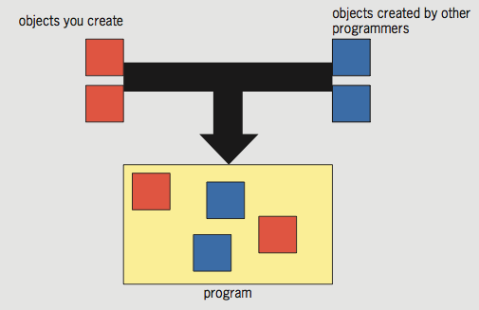
Reusing Software Objects (cont’d.)
Figure 7-1 Programming with objects

Slide 7
What Is Encapsulation?
Encapsulated objects
Code and data contained within the object itself
Encapsulation places code inside a “black box”
Interface
Elements required for program to communicate with an object
Principle of information hiding
Any methods and properties other programmers do not need to access should be hidden

Slide 8
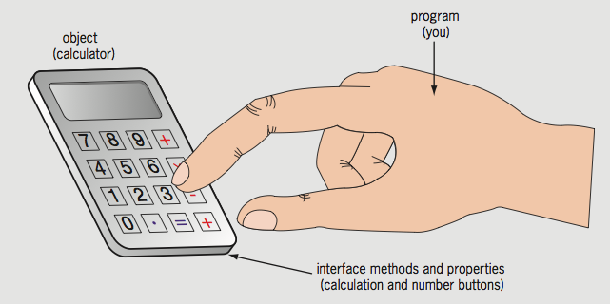
What Is Encapsulation? (cont’d.)
Advantages of encapsulation
Reduces code complexity
Prevents accidental bugs and stealing of code
Programming object and its interface
Compare to a handheld calculator
Figure 7-2 Calculator interface

Slide 9
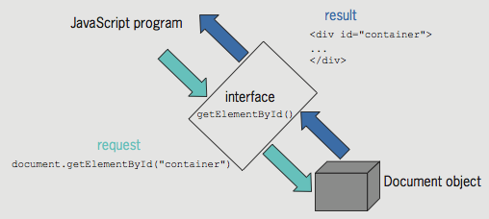
What Is Encapsulation? (cont’d.)
Document object is encapsulated (black box)
getElementById() method
Part of the interface JavaScript uses to communicate with the Document object
Microsoft Word: example of an object and its interface
Figure 7-3 Using the interface for the Document object

Slide 10
Understanding Classes
Classes
Grouping of code, methods, attributes, etc., making up an object
Instance
Object created from an existing class
Instantiate: create an object from an existing class
Instance of an object inherits its methods and properties from a class
Objects in the browser object model
Part of the web browser
No need to instantiate them to use them

Slide 11
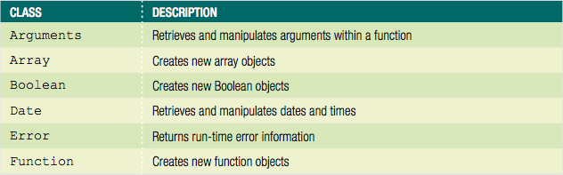
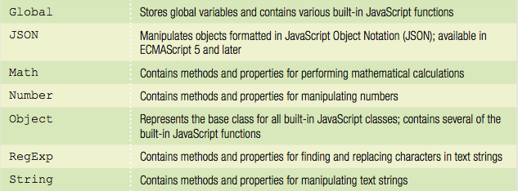
Using Built-In JavaScript Classes
Table 7-1 Built-in JavaScript classes

Slide 12
Using Built-In JavaScript Classes (cont’d.)
Instantiating an object
Some of the built-in JavaScript objects used directly in code
Some objects require programmer to instantiate a new object
Example: Math object’s PI(π) property in a script
// calculate the area of a circle based on its radius
^{function calcCircleArea() {}
var r = document.getElementById("radius").value;
var area = Math.PI * Math.pow(r, 2); // area is pi times ↵
^{radius squared}
^{return area;}
}

Slide 13
Using Built-In JavaScript Classes (cont’d.)
Instantiating an object (cont’d.)
Can instantiate Array object using array literal
Example: ^{var deptHeads = [];}
Can instantiate empty generic object using object literal
Example: ^{var accountsPayable = {};}
Generic object literal uses curly braces around value
Can't use object literal for Date object
Must use constructor
Example: ^{var today = new Date();}

Slide 14
Using Built-In JavaScript Classes (cont’d.)
Performing garbage collection
Garbage collection
Cleaning up, or reclaiming, memory reserved by a program
Declaring a variable or instantiating a new object
Reserves memory for the variable or object
JavaScript knows when a program no longer needs a variable or object
Automatically cleans up the memory

Slide 15
Using the Date, Number, and Math Classes
Three of most commonly used JavaScript classes:
Date, Number, and Math

Slide 16
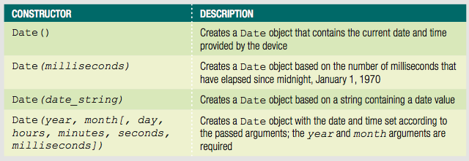
Manipulating the Date and Time with the Date Class
Date class
Methods and properties for manipulating the date and time
Allows use of a specific date or time element in JavaScript programs
Table 7-2 Date class constructors

Slide 17
Manipulating the Date and Time with the Date Class (cont’d.)
Example:
^{var today = new Date();}
Month and year date representation in a Date object
Stored using numbers matching actual date and year
Days of the week and months of the year
Stored using numeric representations
Starting with zero: similar to an array
Example:
var independenceDay = new Date(1776, 6, 4);

Slide 18
Manipulating the Date and Time with the Date Class (cont’d.)
After creating a new Date object
Manipulate date and time in the variable using the Date class methods
Date and time in a Date object
Not updated over time like a clock
Date object contains the static (unchanging) date and time
Set at the moment the JavaScript code instantiates the object

Slide 19
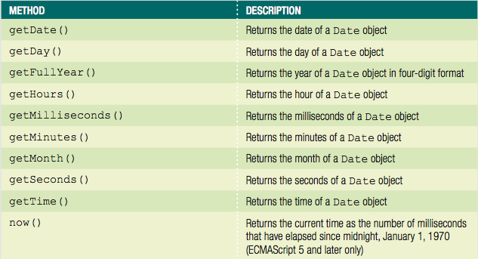
Manipulating the Date and Time with the Date Class (cont’d.)
Table 7-3 Commonly used methods of the Date class (continues)

Slide 20
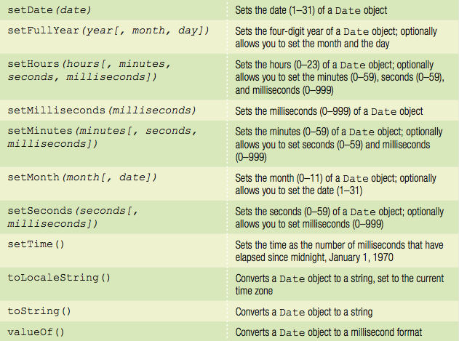
Manipulating the Date and Time with the Date Class (cont’d.)
Table 7-3 Commonly used methods of the Date class

Slide 21
Manipulating the Date and Time with the Date Class (cont’d.)
Each portion of a Date object can be retrieved and modified using the Date object methods
Examples:
var curDate = new Date();
curDate.getDate();
Displaying the full text for days and months
Use a conditional statement to check the value returned by the getDay() or getMonth() method
Example:
if/else construct to print the full text for the day of the week returned by the getDay() method

Slide 22
Manipulating the Date and Time with the Date Class (cont’d.)
^{var today = new Date();}
^{var curDay = today.getDay();}
^{var weekday;}
^{if (curDay === 0) {}
^{weekday = "Sunday";}
^{} else if (curDay === 1) {}
^{weekday = "Monday";}
^{} else if (curDay === 2) {}
^{weekday = "Tuesday";}
^{} else if (curDay === 3) {}
^{weekday = "Wednesday";}
^{} else if (curDay === 4) {}
^{weekday = "Thursday";}
^{} else if (curDay === 5) {}
^{weekday = "Friday";}
^{} else if (curDay === 6) {}
^{weekday = "Saturday";}
}

Slide 23
Manipulating the Date and Time with the Date Class (cont’d.)
Example: include an array named months
12 elements assigned full text names of the months
^{var today = new Date();}
var months = ["January","February","March",↵
^{"April","May","June",↵}
^{"July","August","September",↵}
"October","November","December"];
var curMonth = months[today.getMonth()];

Slide 24
Manipulating Numbers with the Number Class
Number class
Methods for manipulating numbers and properties containing static values
Representing some numeric limitations in the JavaScript language
Can append the name of any Number class method or property
To the name of an existing variable containing a numeric value

Slide 25
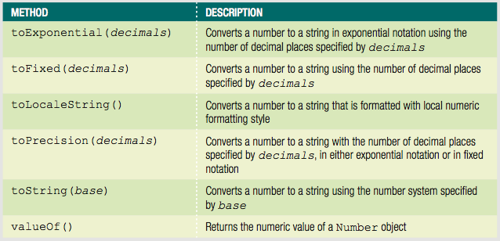
Manipulating Numbers with the Number Class (cont’d.)
Using Number class methods
Table 7-4 Number class methods

Slide 26
Manipulating Numbers with the Number Class (cont’d.)
Using Number class methods (cont’d.)
Primary reason for using any of the “to” methods
To convert a number to a string value with a specific number of decimal places
toFixed() method
Most useful Number class method
toLocaleString() method
Converts a number to a string formatted with local numeric formatting conventions

Slide 27
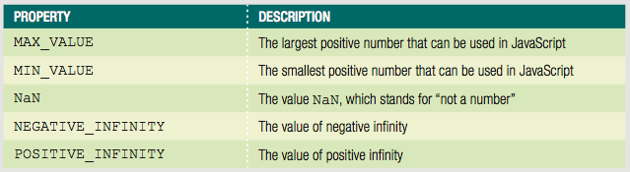
Manipulating Numbers with the Number Class (cont’d.)
Accessing Number class properties
Table 7-5 Number class properties

Slide 28
Performing Math Functions with the Math Class
Math class
Methods and properties for mathematical calculations
Cannot instantiate a Math object using a statement such as: var mathCalc = new Math();
Use the Math object and one of its methods or properties directly in the code
Example:
^{var curNumber = 144;}
var squareRoot = Math.sqrt(curNumber); // returns 12

Slide 29
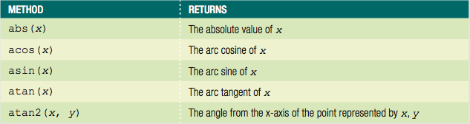
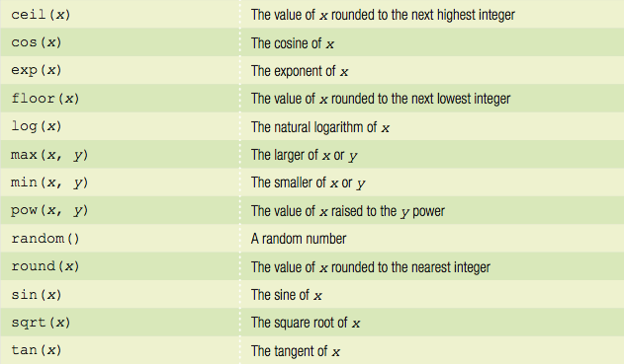
Performing Math Functions with the Math Class (cont’d.)
Table 7-6 Math class methods

Slide 30
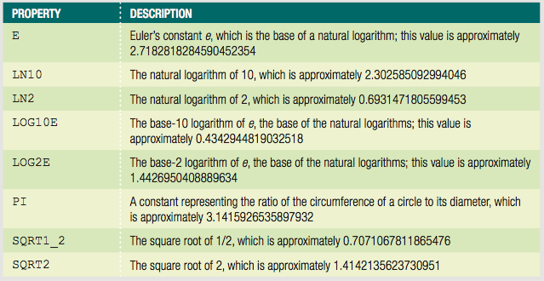
Performing Math Functions with the Math Class (cont’d.)
Table 7-7 Math class properties

Slide 31
Performing Math Functions with the Math Class (cont’d.)
Example:
Use the PI property to calculate the area of a circle based on its radius
Code uses the pow() method to raise the radius value to second power, and the round() method to round the value returned to the nearest whole number
^{var radius = 25;}
var area = Math.PI * Math.pow(radius, 2);
var roundedArea = Math.round(area); // returns 1963

Slide 32
Defining Custom JavaScript Objects
JavaScript: not a true object-oriented programming language
Cannot create classes in JavaScript
Instead, called an object-based language
Can define custom objects
Not encapsulated
Useful to replicate the same functionality an unknown number of times in a script

Slide 33
Declaring Basic Custom Objects
Use the Object object
^{var objectName = new Object();}
^{var objectName = {};}
Can assign properties to the object
Append property name to the object name with a period

Slide 34
Declaring Basic Custom Objects (cont'd.)
Add properties using dot syntax
Object name followed by dot followed by property name
Example:
InventoryList.inventoryDate = new Date(2017, 11, 31);

Slide 35
Declaring Basic Custom Objects (cont'd.)
Can assign values to the properties of an object when object first instantiated
Example:
^{var PerformanceTickets = {}
customerName: "Claudia Salomon",
^{performanceName: "Swan Lake",}
^{ticketQuantity: 2,}
performanceDate: new Date(2017, 6, 18, 20)
};

Slide 36
Declaring Sub-Objects
Value of a property can be another object
called a sub-object
Example–order object with address sub-object:
^{var order = {}
^{orderNumber: "F5987",}
^{address: {}
^{street: "1 Main St",}
^{city: "Farmington",}
^{state: "NY",}
^{zip: "14425"}
}
};

Slide 37
Referring to Object Properties as Associative Arrays
Associative array
An array whose elements are referred to with an alphanumeric key instead of an index number
Can also use associative array syntax to refer to the properties of an object
With associative arrays
Can dynamically build property names at runtime

Slide 38
Referring to Object Properties as Associative Arrays (cont'd.)
Can use associative array syntax to refer to the properties of an object
Example:
^{var stopLightColors = {}
^{stop: "red",}
^{caution: "yellow",}
^{go: "green"}
};
^{stopLightColors["caution"];}

Slide 39
Referring to Object Properties as Associative Arrays (cont'd.)
Can easily reference property names that contain numbers
Example:
^{var order = {}
^{item1: "KJ2435J",}
^{price1: 23.95,}
^{item2: "AW23454",}
^{price2: 44.99,}
^{item3: "2346J3B",}
^{price3: 9.95}
};

Slide 40
Referring to Object Properties as Associative Arrays (cont'd.)
Can easily reference property names that contain numbers (cont'd.)
To create order summary:
^{for (var i = 1; i < 4; i++) {}
document.getElementById("itemList").innerHTML +=↵
"<p class='item'>" + order["item" + i] + "</p>";
document.getElementById("itemList").innerHTML +=↵
"<p class='price'>" + order["price" + i] + "</p>";
};

Slide 41
Referring to Object Properties as Associative Arrays (cont'd.)
Can also write generic code to add new object properties that incorporate numbers
Example—adding items to shopping cart:
totalItems += 1; // increment counter of items in order
currentItem = document.getElementById("itemName").innerHTML;
currentPrice = document.getElementById("itemPrice").innerHTML;
newItemPropertyName = "item" + totalItems; // "item4"
newPricePropertyName = "price" + totalItems; // "price4"
order.newItemPropertyName = currentItem; // order.item4 = (name)
order.newPricePropertyName = currentPrice;
^{// order.price4 = (price);}
Allows for as many items as user wants to purchase

Slide 42
Creating Methods
Object method simply a function with a name within the object
Two ways to add method to object
Provide code for method in object
Reference external function

Slide 43
Creating Methods (cont'd.)
Specify method name with anonymous function as value
Example:
^{var order = {}
^{items: {},}
^{generateInvoice: function() {}
^{// function statements}
}
};

Slide 44
Creating Methods (cont'd.)
Specify method name with existing function as value
Example:
Reference to existing function cannot have parentheses
^{function processOrder() {}
^{// function statements}
}
^{var order = {}
^{items: {},}
^{generateInvoice: processOrder}
};

Slide 45
Enumerating custom object properties
Custom objects can contain dozens of properties
To execute the same statement or command block for all the properties within a custom object
Use the for/in statement
Looping statement similar to the for statement
Syntax
^{for (variable in object) {}
^{statement(s);}
}

Slide 46
Enumerating custom object properties (cont'd.)
for/in statement enumerates, or assigns an index to, each property in an object
Typical use:
validate properties within an object

Slide 47
Enumerating custom object properties (cont’d.)
Example—checking for empty values:
^{var item={}
^{itemNumber: "KJ2435J",}
^{itemPrice: 23.95,}
^{itemInstock: true,}
itemShipDate: new Date(2017, 6, 18),
};
^{for (prop in order) {}
^{if (order[prop] === "") {}
^{order.generateErrorMessage();}
}
}

Slide 48
Deleting Properties
Use the delete operator
Syntax
delete object.property
Example:
^{delete order.itemInStock;}

Slide 49
Defining Constructor Functions
Constructor function
Used as the basis for a custom object
Also known as object definition
JavaScript objects
Inherit all the variables and statements of the constructor function on which they are based
All JavaScript functions
Can serve as a constructor

Slide 50
Defining Constructor Functions (cont’d.)
Example:
Define a function that can serve as a constructor function
function Order(number, order, payment, ship) {
^{this.customerNumber = number;}
^{this.orderDate = order;}
^{this.paymentMethod = payment;}
^{this.shippingDate = ship;}
}

Slide 51
Adding Methods to a Constructor Function
Can create a function to use as an object method
Refer to object properties with this reference
Example:
^{function displayOrderInfo() {}
var summaryDiv = document.getElementById("summarySection");
summaryDiv.innerHTML += ("<p>Customer: " +↵
^{this.customerNumber + "</p>");}
summaryDiv.innerHTML += ("<p>Order Date: " +↵
this.orderDate.toLocaleString()+ "</p>");
summaryDiv.innerHTML += ("<p>Payment: " +↵
^{this.paymentMethod + "</p>");}
summaryDiv.innerHTML += ("<p>Ship Date: " +↵
this.shippingDate.toLocaleString() + "</p>");
}

Slide 52
Using the prototype Property
After instantiating a new object
Can assign additional object properties
Use a period
New property only available to that specific object
prototype property
Built-in property that specifies the constructor from which an object was instantiated
When used with the name of the constructor function
Any new properties you create will also be available to the constructor function

Slide 53
Using the prototype Property (cont’d.)
Object definitions can use the prototype property to extend other object definitions
Can create a new object based on an existing object

Slide 54
Summary
Object-oriented programming (or OOP)
The creation of reusable software objects
Reusable software objects
Called components
Object
Programming code and data treated as an individual unit or component
Objects are encapsulated
Interface represents elements required for a source program to communicate with an object

Slide 55
Summary (cont’d.)
Principle of information hiding
Code, methods, attributes, and other information that make up an object
Organized using classes
Instance
Object created from an existing class
An object inherits the characteristics of the class on which it is based
Date class contains methods and properties for manipulating the date and time

Slide 56
Summary (cont’d.)
Number class contains methods for manipulating numbers and properties
Math class contains methods and properties for performing mathematical calculations
Can define custom object
object literal
Can create template for custom objects
constructor function
this keyword refers to object that called function
prototype property specifies object's constructor

